Slide 1

Team 5
Anusha Muniraju
Dharshini Bala Soundararaj
Nihar Shiva Kumar
Prriyamvradha Parthasarathi

Slide 2

Problem Statement: The current process for U.S. headquartered companies to report country-by-country information to the IRS (Internal Revenue Service) is burdensome and inefficient, leading to difficulties in measuring the fiscal and economic contributions of businesses to the economy. The objective is to create a solution that simplifies and streamlines the reporting process, guarantees the accuracy of the information submitted, and improves the speed of information exchange between the IRS and international tax authorities.

Slide 3
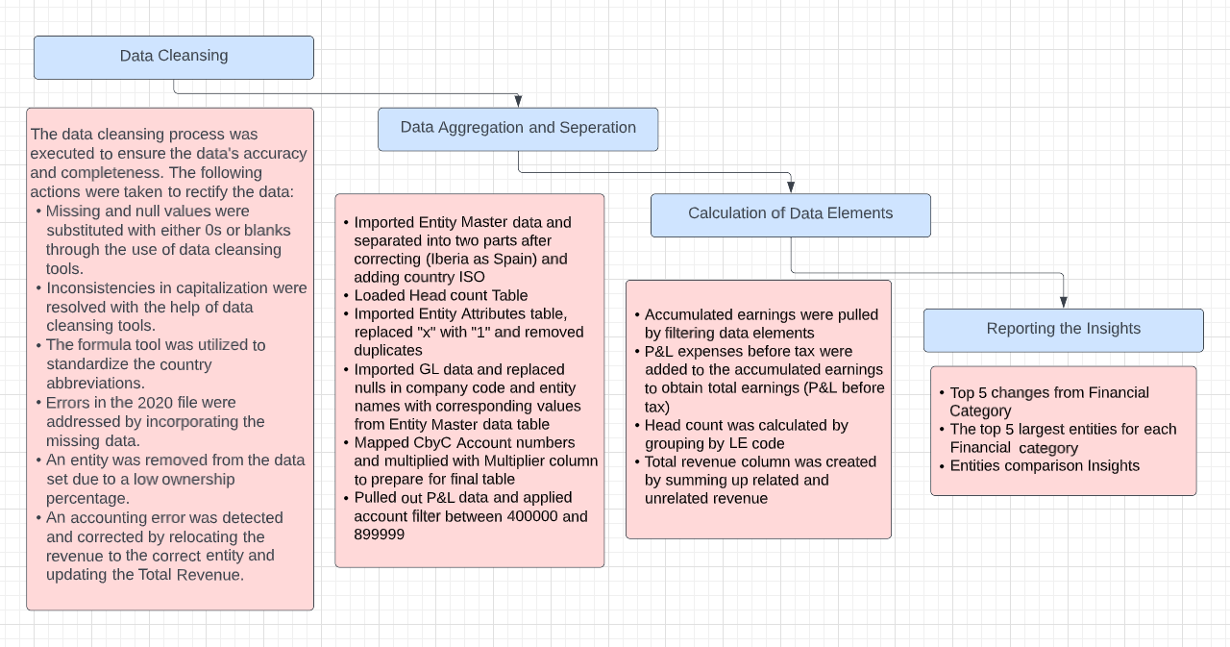
Executive Summary

Slide 4
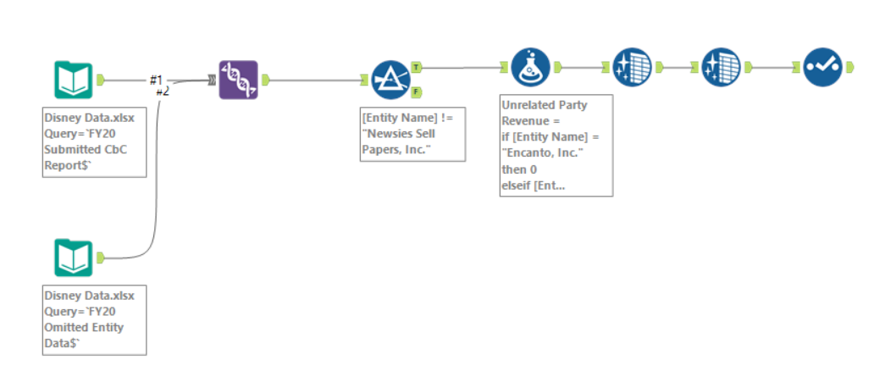
Financial Year 2020 - Workflow

Slide 5
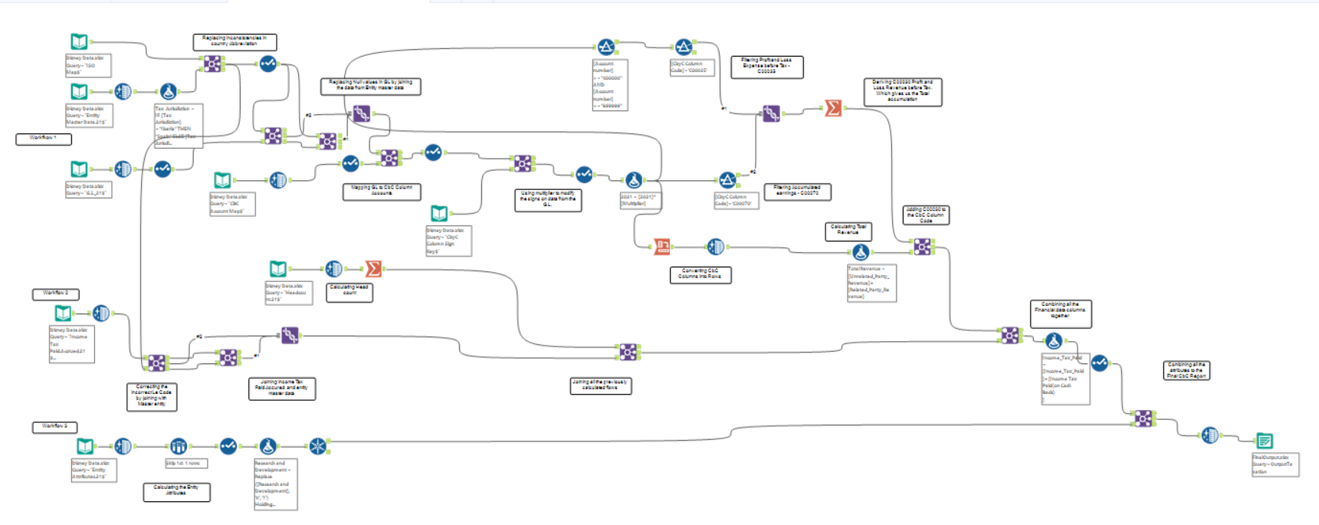
Financial Year 2021 - Workflow

Slide 6
The top 5 largest entities for each Financial category
Tax Jurisdiction | Country (ISO) | Entity Name | Unrelated Party Revenue
Israel | IS | Hook's Clocks, LLC | 28426191851
United Kingdom | UK | Pooh's Perfect Pictures, Inc. | 17192440781
Japan | JA | It's A Small World, LLC | 13842581501
Israel | IS | Ariel's Art Gallery, Inc. | 10639614513
Spain | ES | Mickey's Merry Restaurants, Inc. | 7598866380

Slide 7
The top 5 largest entities for each Financial category
Tax Jurisdiction​ | Country (ISO)​ | Entity Name​ | Related Party Revenue​
Belgium​ | BE​ | Charlotte's Birthday Cakes, LLC​ | 8711138638​
United States​ | US​ | Wakanda Forever, Inc.​ | 7909255401​
Singapore​ | SG​ | Hollywood Studios, Inc.​ | 5098477377​
China​ | CN​ | The Contemporary, LLC​ | 4944960909​
France​ | FR​ | The Enchanted Rose Corp.​ | 3862898199​

Slide 8
The top 5 largest entities for each Financial category
Tax Jurisdiction | Coutnry (ISO) | Entity Name | Total Revenue
Israel | IS | Hook's Clocks, LLC | 28799692652
United Kingdom | UK | Pooh's Perfect Pictures, Inc. | 17194202094
Japan | JA | It's A Small World, LLC | 14631356821
Israel | IS | Ariel's Art Gallery, Inc. | 12399412839
United States | US | Wakanda Forever, Inc. | 11846694831

Slide 9
Entities comparison Insights
Compared to the FY20 report, 6 new entities were added in FY21. They are:
Banner's Anger Management, Inc.
Disney -, LLC
La Aventura Conelada de Anna, SLU
La Tienda de Magia de la Familia Madrigal
Mickey's Merry Restaurants, Inc.
Pepa's Meteorologist Service, LLC
Compared to the FY20 report, 5 old entities were removed in FY21. They are:
Dissolved Dave's Dishwashing Services, Inc.
Liquidated Larry's Lunchtime Supply Co.
Rocket's Radical Mod Company
Runaway Railway, LLC
Captain America's Hamburger Hut, LLC
The number of remaining entities retained is: 200

Slide 10
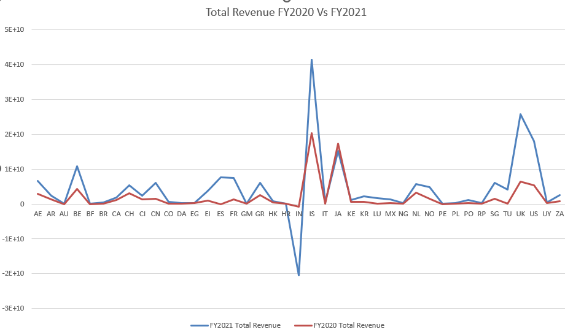
Top 5 changes from Financial Category
The revenue of India has dropped drastically. This may be accounted to covid.
The contribution from Israel is the highest when compared to other countries.
The Denmark, Colorado, Poland has the stable revenue
The overall revenue has increased in total when compared to 2020 and we see that on whole the economy is recovering

Slide 11

Thank you

